Slide 1
ORACLES Forecast Briefing (Aerosols)
16 September 2016

Slide 2
The Aerosol Week

Slide 3
Walvis Bay
UKMO Dust
Sun 0Z
GEOS-5 Dust
Sun 0Z

Slide 4
Ascension Island

Slide 5
Sept 17 2016

Slide 6
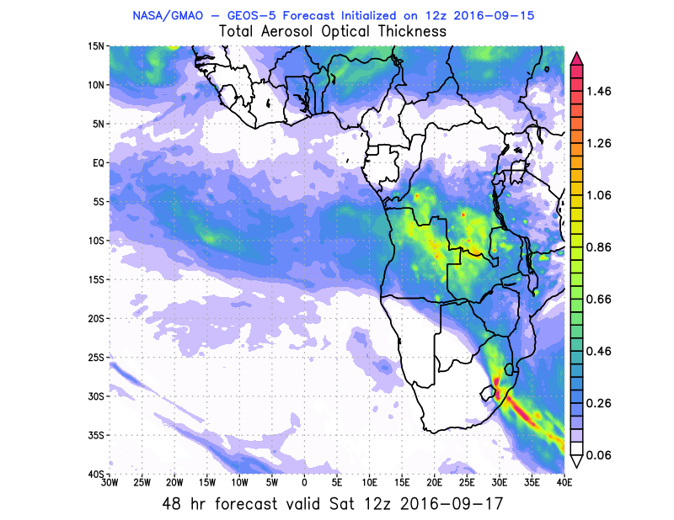
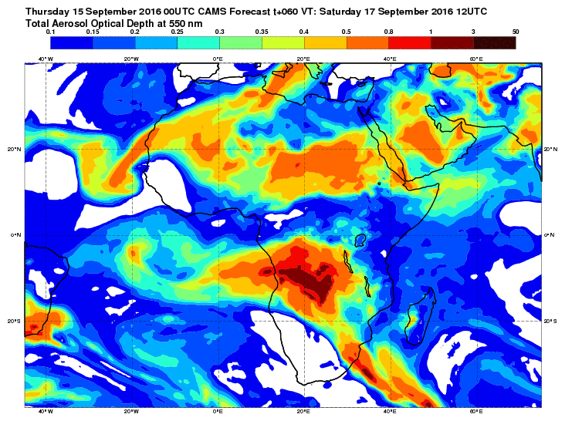
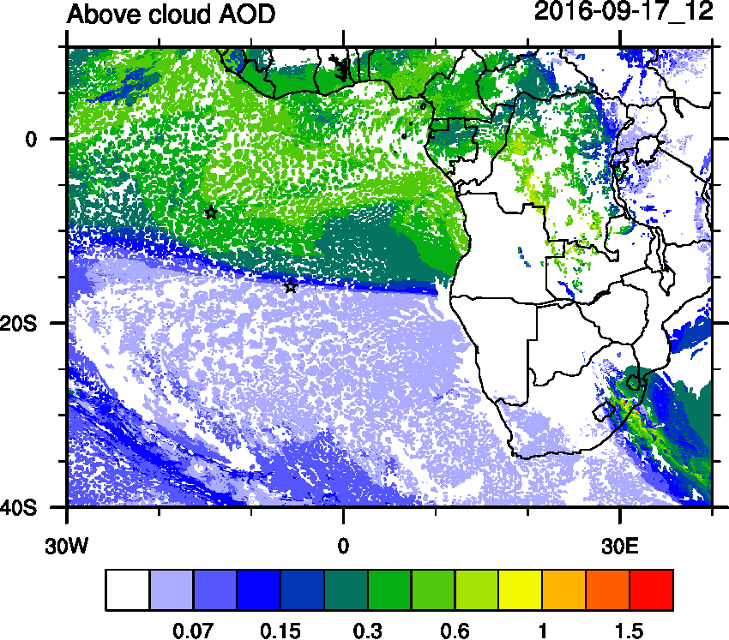
AOD 12 UTC
WRF
GEOS5
CAMS

Slide 7
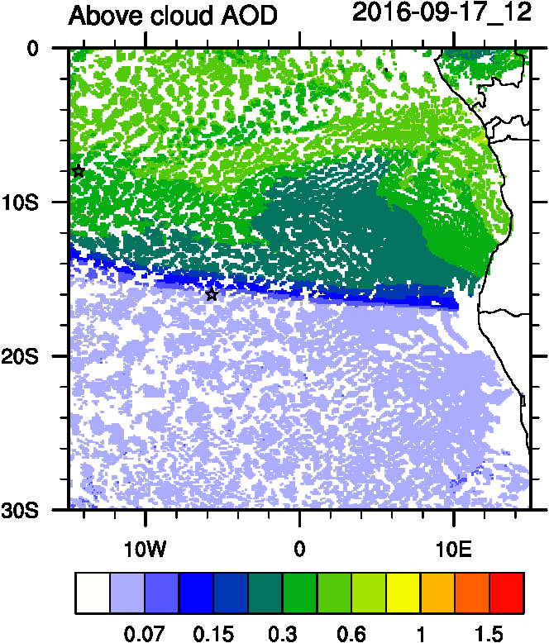
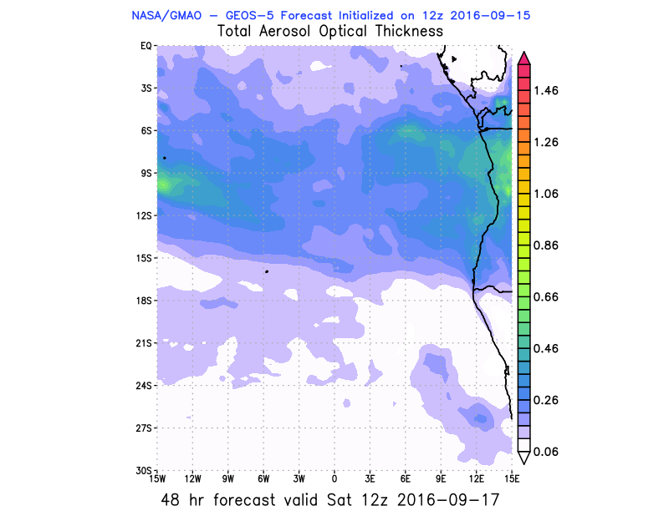
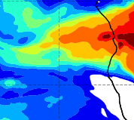
AOD 12 UTC
WRF
CAMS
GEOS5
CAMS

Slide 8
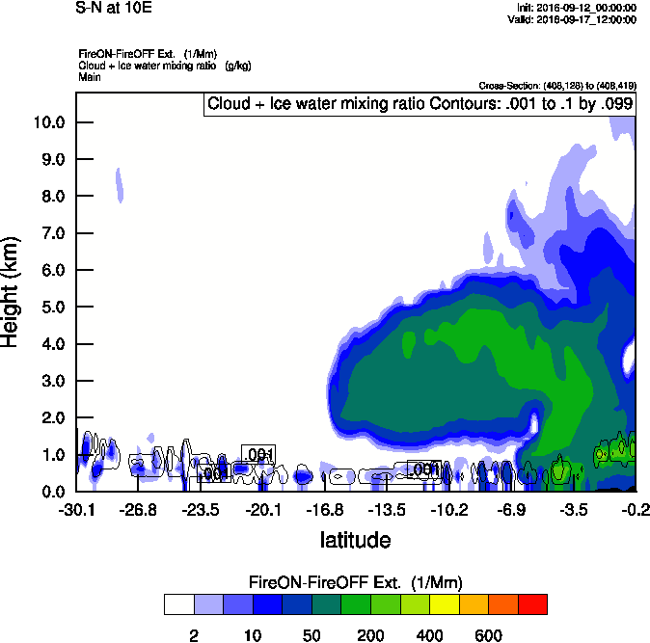
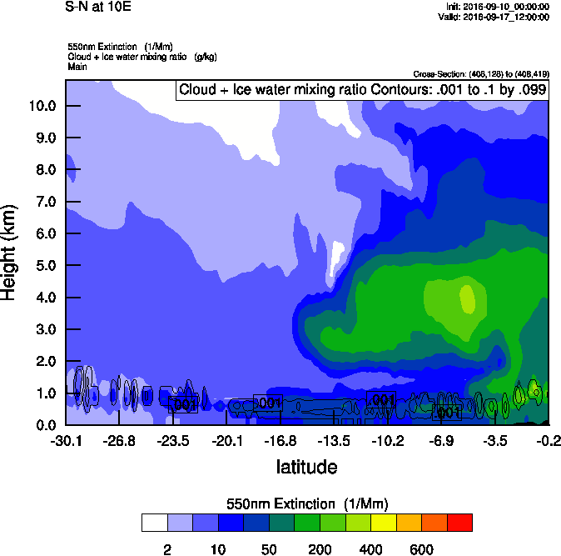
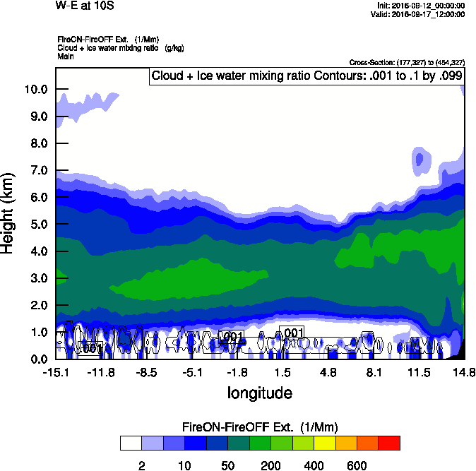
Vertical cross-sections
10 E
Smoke Ext WRF
Smoke Ext WRF
10 S

Slide 9
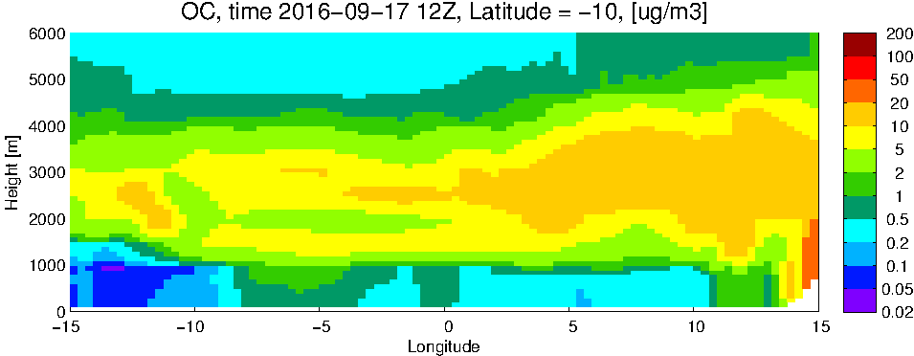
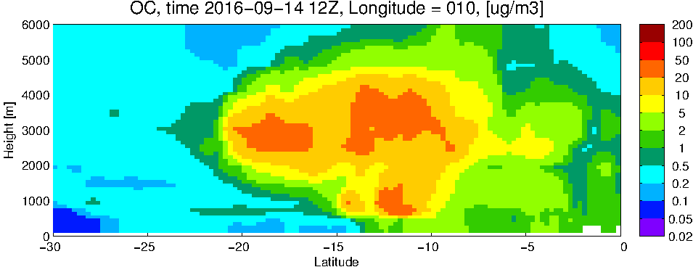
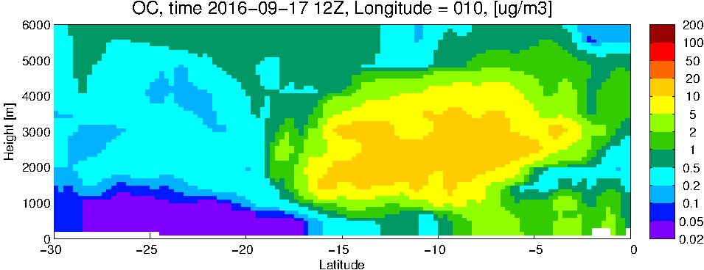
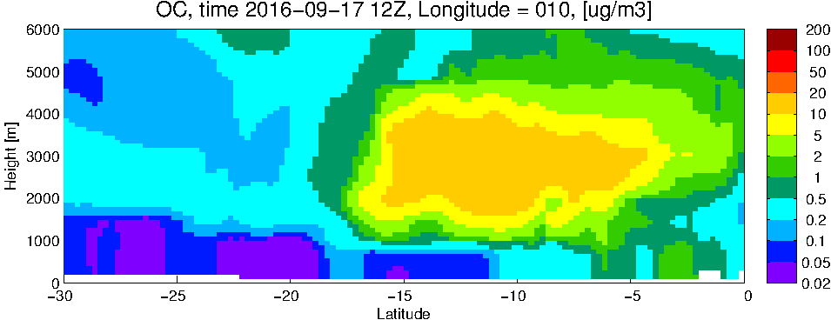
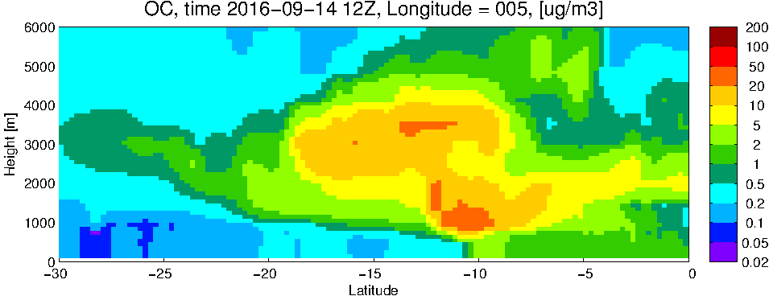
GEOS5 OC curtains
10 S
10 E

Slide 10
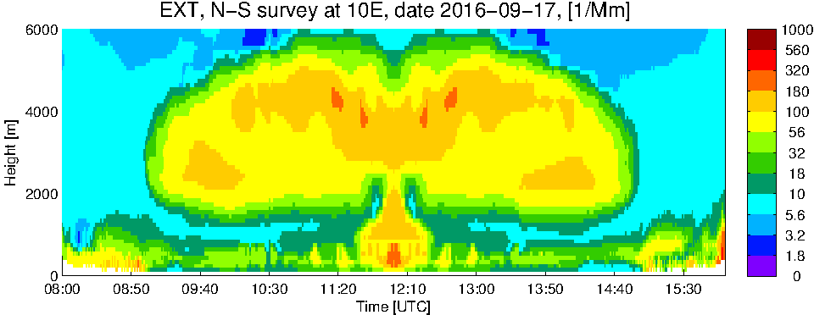
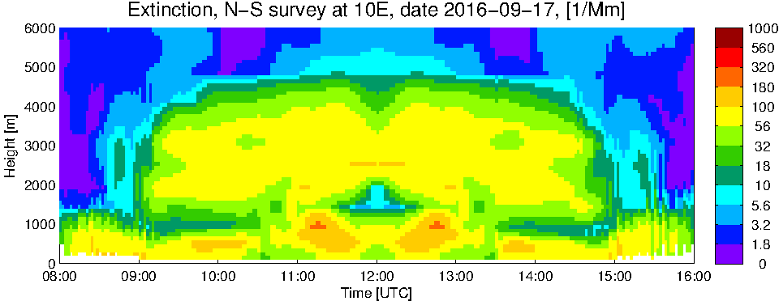
WRF
GEOS5

Slide 11
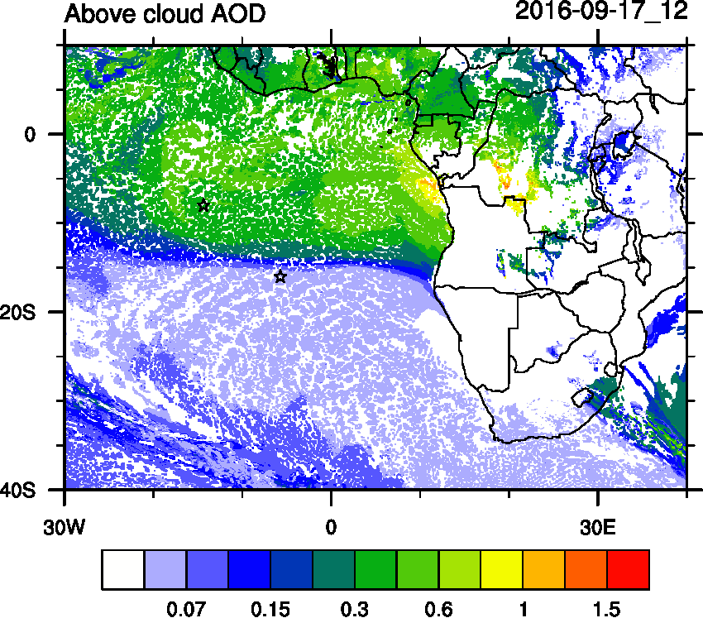
Change in Forecast
NEWEST

Slide 12
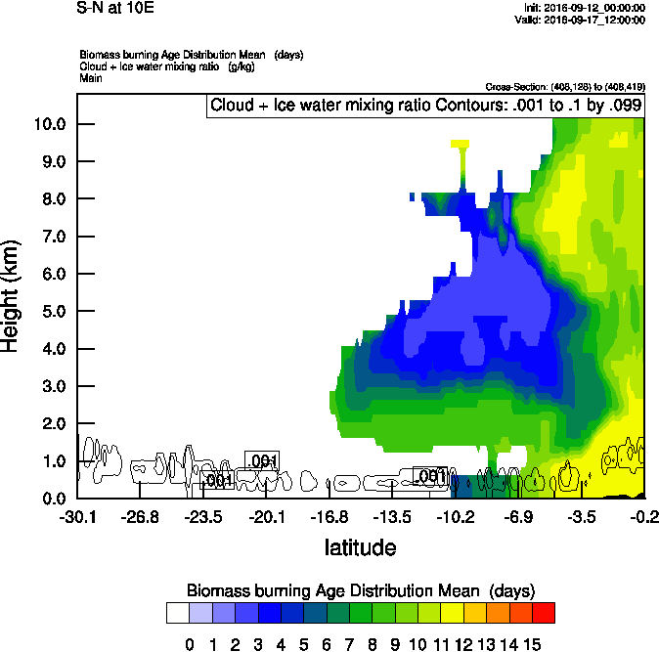
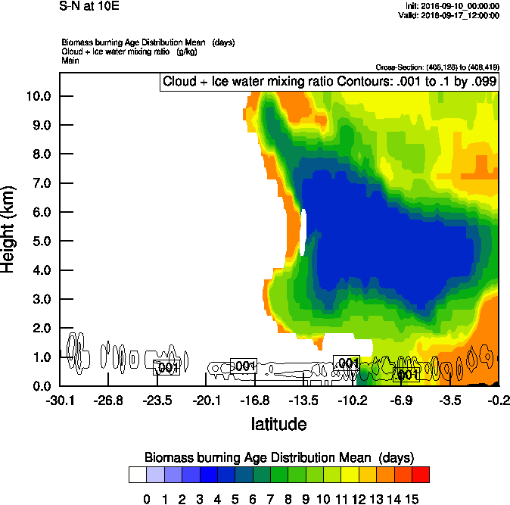
S-N @ 10E Sept 17 (NEWEST) Sept 17 (right)
Smoke Ext WRF

Slide 13
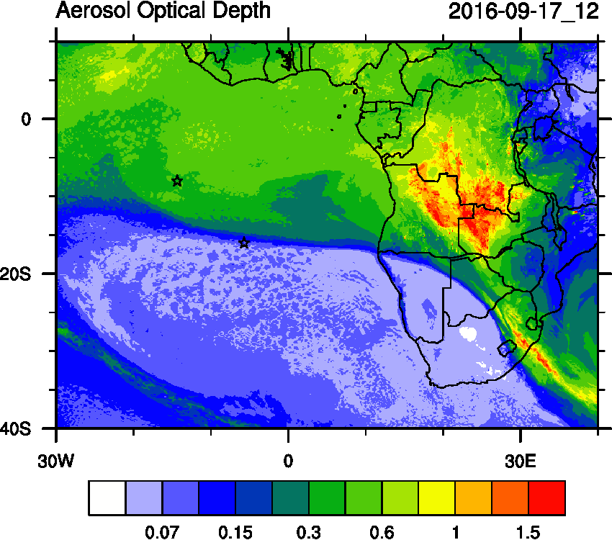
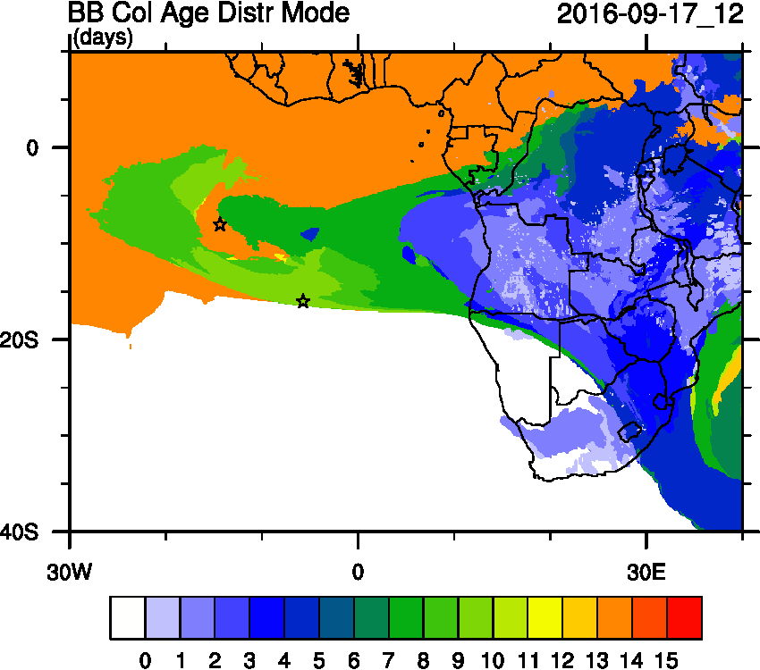
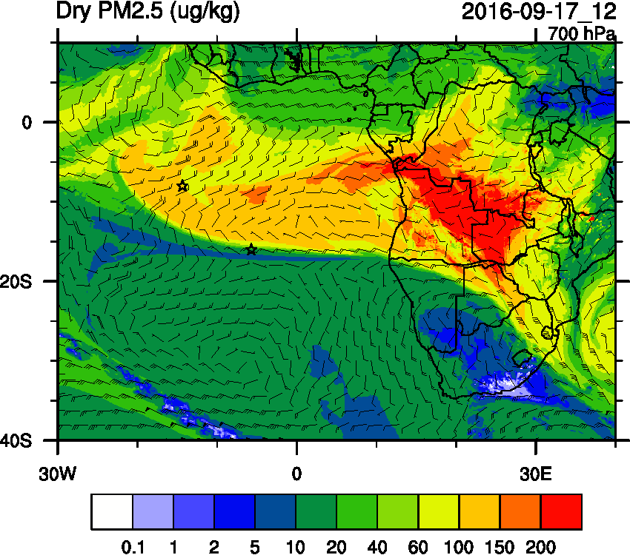
Sept. 17

Slide 14
Sept 18 2016

Slide 15
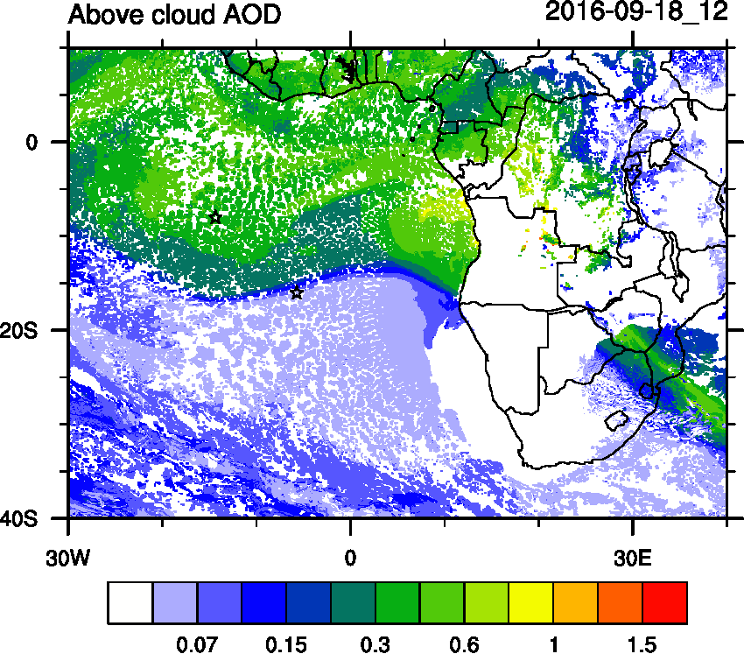
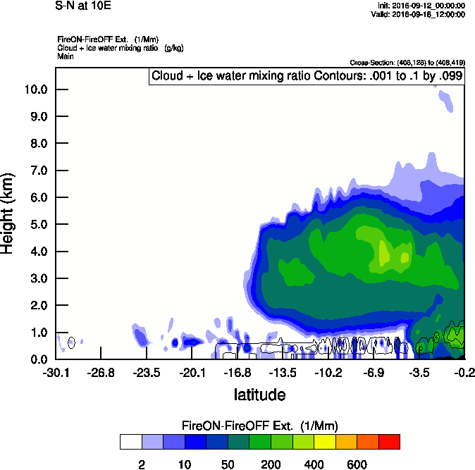
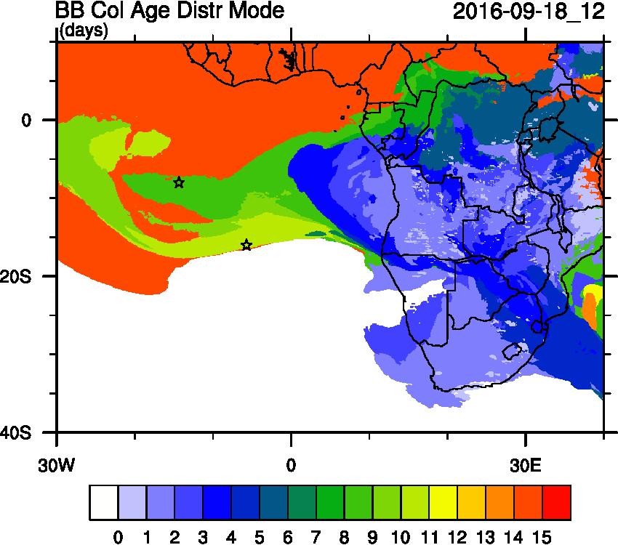
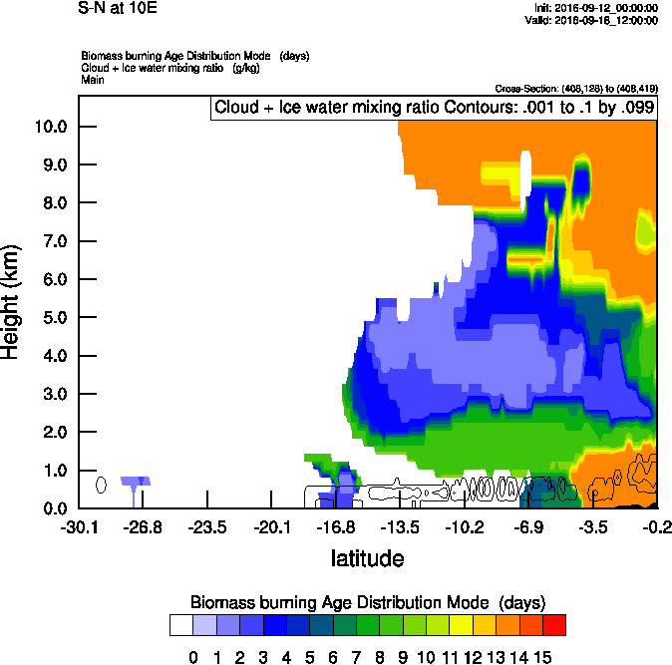
S-N@10E on Sunday
Smoke-EXT
AGE

Slide 16
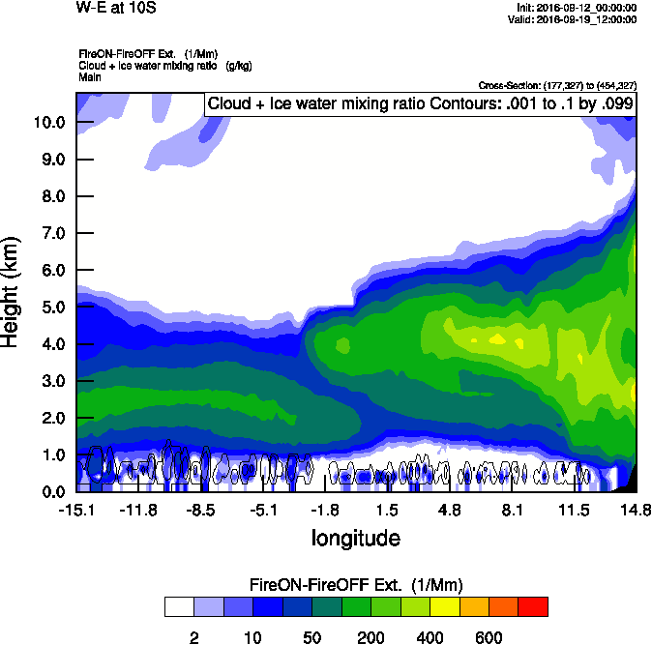
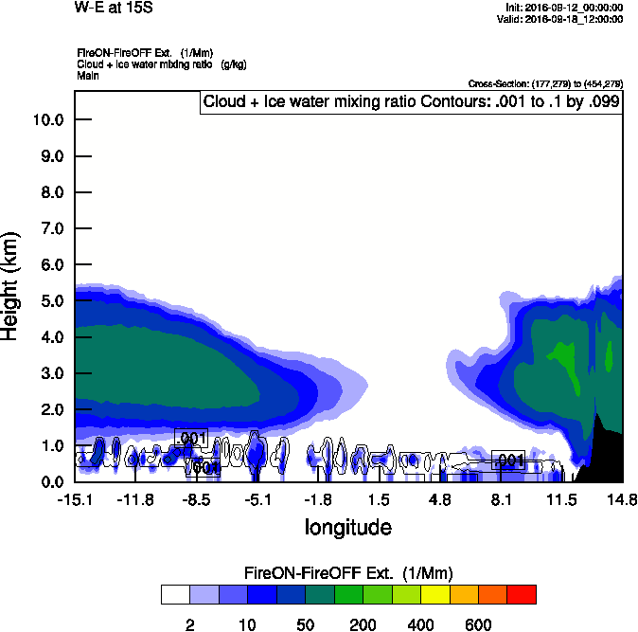
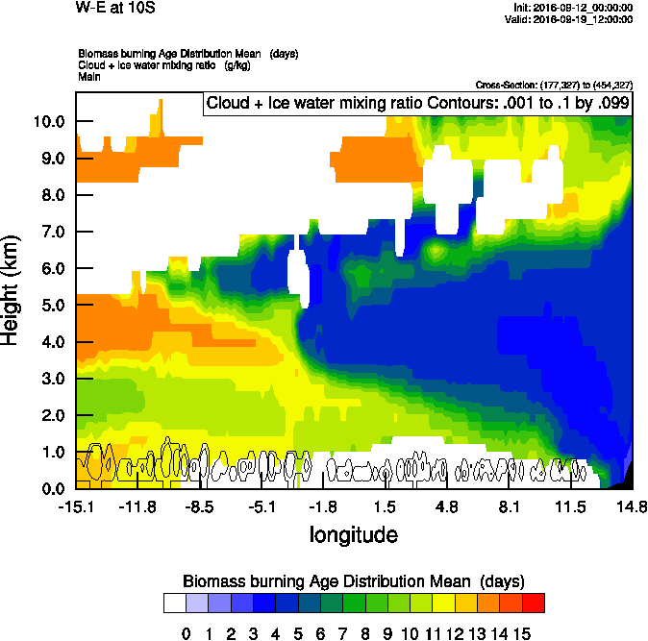
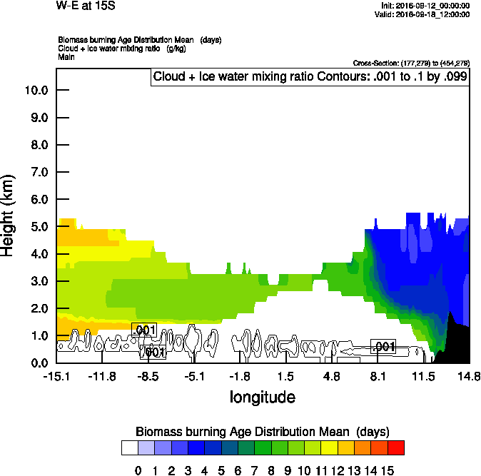
S-N@10S on Sunday

Slide 17
Monday 19 September 2016
Flight Day

Slide 18
Clouds & Aerosols - Mon 2016-09-19 9Z

Slide 19
Dust - Mon 2016-09-19 9Z

Slide 20
4 day
5 day

Slide 21
GEOS-5 AOD on Monday 2016-09-19 12Z

Slide 22
GEOS-5 AOD on Monday 2016-09-19 12Z

Slide 23
GEOS-5 AOD on Monday 2016-09-19 12Z

Slide 24
GEOS-5 AOD on Monday 2016-09-19 12Z

Slide 25
GEOS-5 AOD on Monday 2016-09-19 12Z

Slide 26
Dust
OC

Slide 27
Sulfate
RH

Slide 28
WRF

Slide 29
>10 Days
10 Days
6 Days
4 Days
2 Days
<1 Day
WRF Smoke Age Tracer

Slide 30
GEOS-5
Ext
WRF
Ext

Slide 31
GEOS-5 NW-SE - Speciation

Slide 32
GEOS-5
Ext
WRF
Ext

Slide 33
GEOS-5 E-W at 15S - Speciation

Slide 34
GEOS-5
Ext
WRF
Ext

Slide 35
GEOS-5 N-S at 10E - Speciation

Slide 36
tuesday 19 September 2016
No Fly Day

Slide 37
Clouds & Aerosols - Tue 2016-09-20 9Z

